Slide 1
Rockbuster Stealth Analysis
Bryan Lim
September 4, 2022

Slide 2
Who Are We?
Rockbuster Stealth LLC is a movie rental company that used to have stores around the
world. Facing stiff competition from streaming services such as Netflix and Amazon Prime,
the Rockbuster Stealth management team is planning to use its existing movie licenses to
launch an online video rental service in order to stay competitive.

Slide 3
01
02
Key Questions
03
04
Which movies contributed the most/least to revenue gain?
What was the average rental duration for all videos?
Which countries are Rockbuster customers based in?
Where are customers with a high lifetime value based?
05
Do sales figures vary between geographic regions?

Slide 4
Company Overview
Total # of Customers | 599
Total # of Films | 1000
Average Rental Duration | 5 days
Rental Rate | $0.99 to $4.99
Replacement Cost | $9.99 to $29.99

Slide 5
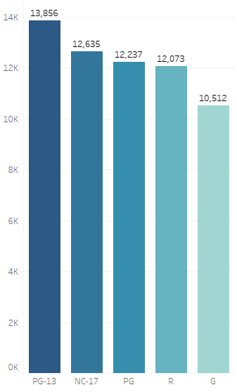
Movie Revenue by Rating
Movies with a PG-13 rating grossed the highest revenue
Movies with a G rating earned the least amount
The remaining three ratings were roughly the same

Slide 6
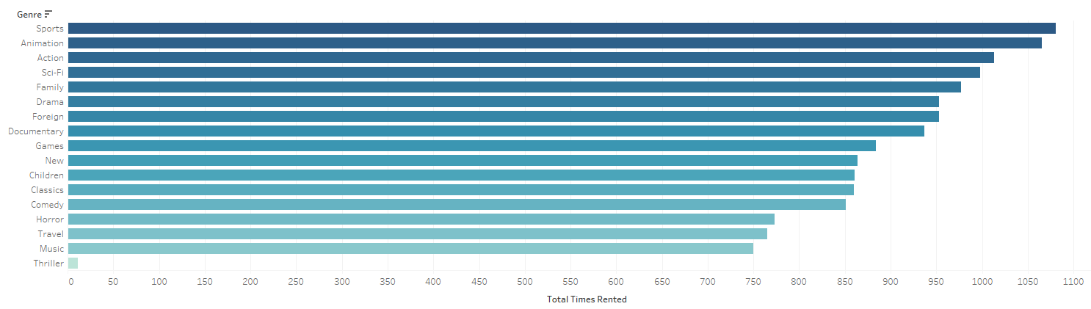
Popular Movie Genres
Sports, Animation, and Action are the top three genres in terms of:
Total times rented
Total revenue generated

Slide 7
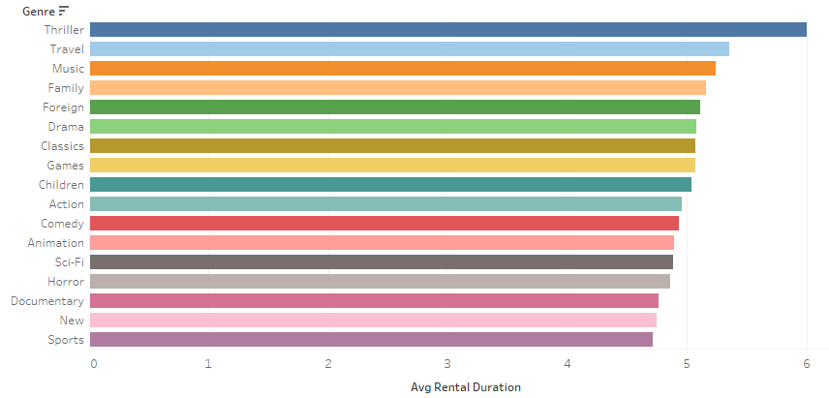
Average Rental Duration by Genre
On average, customers rent for 5 days
Fairly consistent amongst all genres

Slide 8
Which Movies Did the Best/Worst?
TOP 5 FILMS
WORST 5 FILMS
Title | Rating | Genre | Revenue
Telegraph Voyage | PG | Music | $215.75
Zorro Ark | NC-17 | Comedy | $199.72
Wife Turn | NC-17 | Documentary | $198.73
Innocent Usual | PG-13 | Foreign | $191.74
Hustler Party | NC-17 | Comedy | $190.78
Title | Rating | Genre | Revenue
Texas Watch | NC-17 | Horror | $5.94
Oklahoma Jumanji | PG | New | $5.94
Duffel Apocalypse | G | Documentary | $5.94
Freedom Cleopatra | PG-13 | Comedy | $5.95
Rebel Airport | G | Music | $6.93

Slide 9
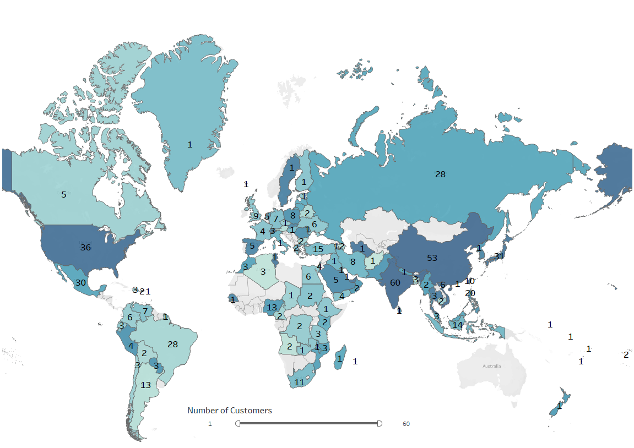
Where Are Our Customers Based?
Located in 108 countries worldwide
Most customers in one country is 60

Slide 10
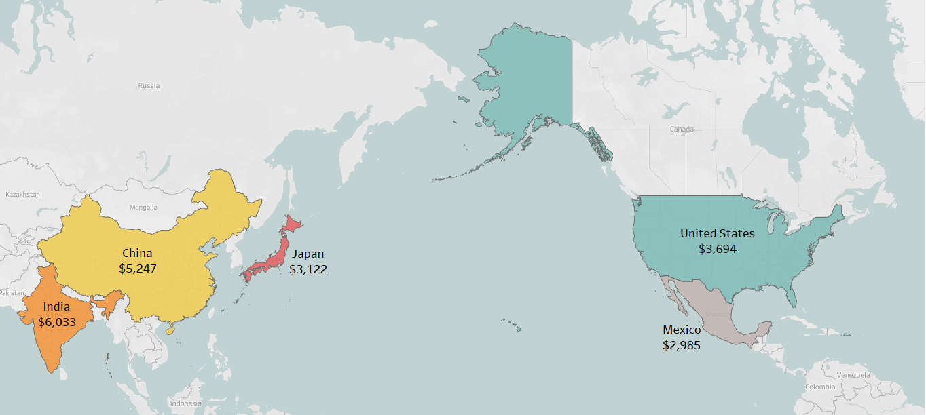
Sales by Regions (Country)
Top 5 countries by revenue
India
China
United States
Japan
Mexico

Slide 11
Top Customers by Revenue
NAME | COUNTRY | REVENUE
Eleanor Hunt | Réunion | $211.55
Karl Seal | United States | $208.58
Marion Snyder | Brazil | $194.61
Rhonda Kennedy | Netherlands | $191.62
Clara Shaw | Belarus | $189.60
The United States is part of the top 5 countries by revenue

Slide 12
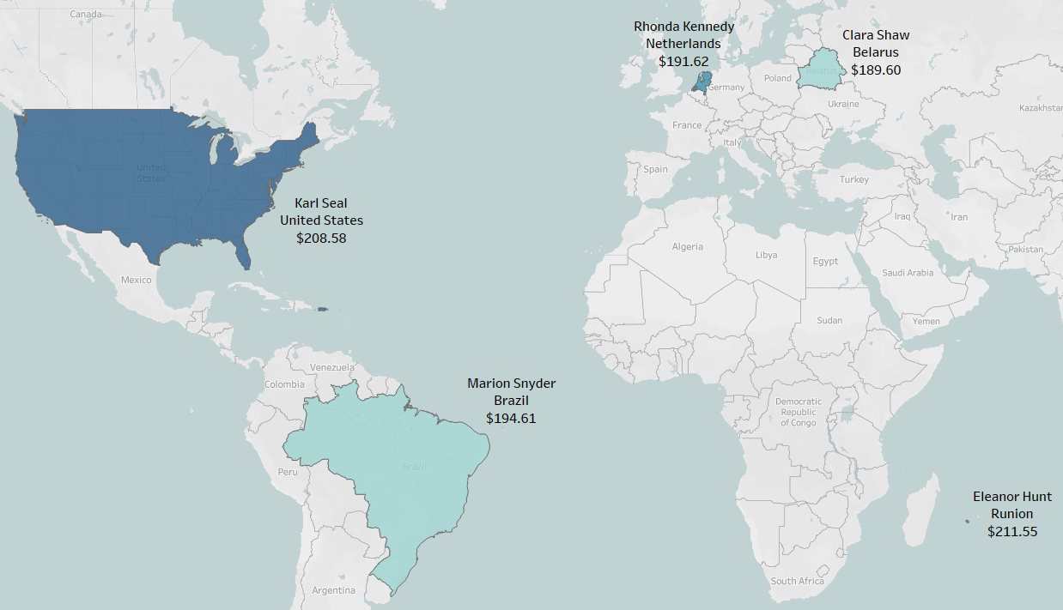

Slide 13
＄61,312
Popular Genres Sports Animation Action
Most Popular Rating PG-13
Biggest Markets India China United States Japan Mexico
How we can improve our services and make more money?

Slide 14
Recommendations
Rockbuster can obtain more movies with the popular genres
Rockbuster should focus on the biggest markets in the top 5 countries
They have the most customers
As the company expands globally, they could consider a rewards program
Will attract new customers and keep loyal ones

Slide 15
THANK YOU!
Do you have any questions?
Bryan Lim
bryan.lim@futuretechcompany.com
Tableau

